Slide 1
INVESTMENT CASE STUDY SUBMISSION
Individual submission
Member name- Kuldip Singh Chauhan

Slide 2
Spark Funds- Understanding the global Investment trends.
Spark fund is a asset management company interested in making investments in companies in various stages of growth including
Seed and Angel funding – for early growth phase for start ups
Venture Funding- post early phase with slightly higher investment requirement
Private Equity – in large companies or established start-up for business scale.
Investment Constraints
Investments should be between $5MM-15MM per round of investment.
Investment in English speaking countries for better control/communication
Investment philosophy.
- Investing where most of the investors are investing.

Slide 3
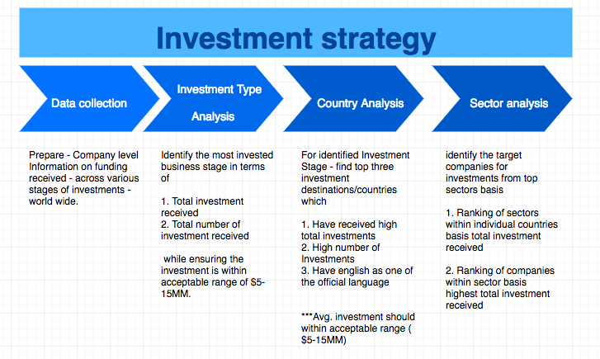
Problem solving methodology

Slide 4
Data collection and missing value Handling.
Data pulled from two files provided –companies and Rounds2 with read CSV using Palmosas encoding. Basis the overall understanding of the business objectives certain columns have been delegated as redundant with high number of missing values for example in
Missing values in columns
Companies–‘state_code’, ‘region’, ‘city’ and‘founded_at’.
Rounds2–‘funding_round_code’ and ‘funded_at’ (pls. note ‘funded_at’ column doesn't’t have missing value- however is not used in analysis –hence removed)
2. Missing values in Rows.
‘raised_amount_usd’ in Round2 has missing values –however column is central to analysis
Also the spread of the variable is such that it cant be imputed –hence all the rows with missing values –were removed from analysis.
3. Merging of data frame –Companies and Rounds2 were merged using common variable –permalink through outer join so that there is no loss of data for analysis of preferred investment type. There is ~$107MM of investment for which information is available in in rounds2 table alone.

Slide 5
Investment Round Type and Country Analysis
1. The merged Data frame was grouped basis the Investment round Type to check ranking of 'funding_round_type' done on 'raised_amount_usd' basis
Total investment received
Total number of Investment received
Average investment for each type.
It is observed that with $590BN in total investment accross ~50K investment – Venture is the most suitable investment type for Spark Funds. Also it is noted that the average investment in Venture is ~$11.7 MM which is well within acceptable investment range.
2. Merged data frame is then sliced for 'funding_round_type' = 'venture' for Country Analysis. Grouping of the data done basis Country code on which Ranking of "country_code" done on 'raised_amount_usd' basis
Total investment received
Total number of Investment received
Average investment for each type.
It is observed that among the counties with English as one of the official language the ranking of the countries in terms of total investment is – 1st - USA, 2nd– GBR and 3rd – IND. In terms of total number of investments 1st – USA , 2nd – GBR and 3rd- CAN. Finally the average Investment across the 4 country shows that in India the Avg. investment is beyond acceptable Investment range for Spark Funds. Hence USA, GBR and CAN were selected as top destinations for Spark funds

Slide 6
Sector Analysis with company selection
'category_list'- which is basically as subsector is mapped to 8 Main sectors identified for finding Investment opportunities.
The data is then sliced – country wise for top three destinations identified in country analysis through creation of three new data sets.
With in these data sets – each data set is further sliced

Slide 7
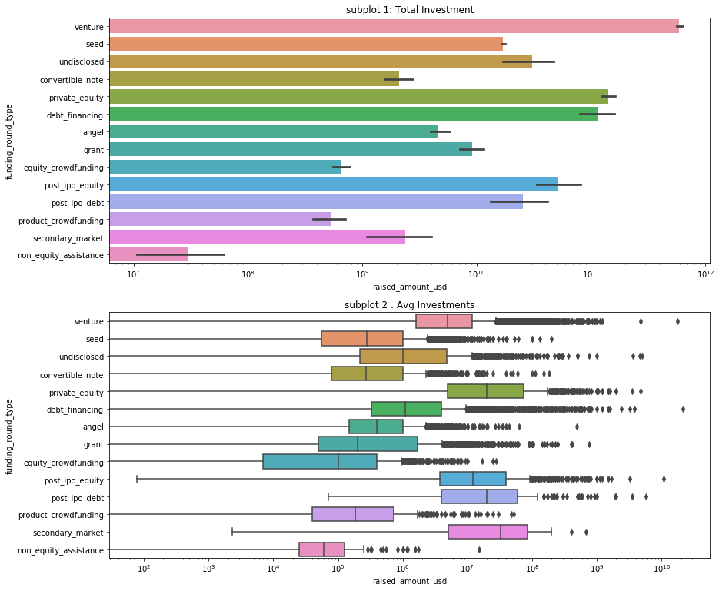
Best Investment Type – Venture

Slide 8
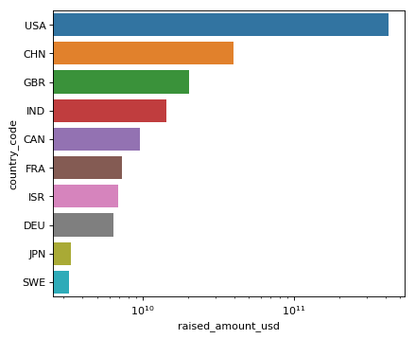
Top 9 Countries in terms of Investments
Please note the list of the countries – also include countries where English is not one of the official language.
The Graph shows top three English speaking countries to be USA, GBR(UK) and IND, however the average investment in India is $17.5MM which is higher than acceptable investment range for Spark Funds hence – CAN was selected over IND.

Slide 9
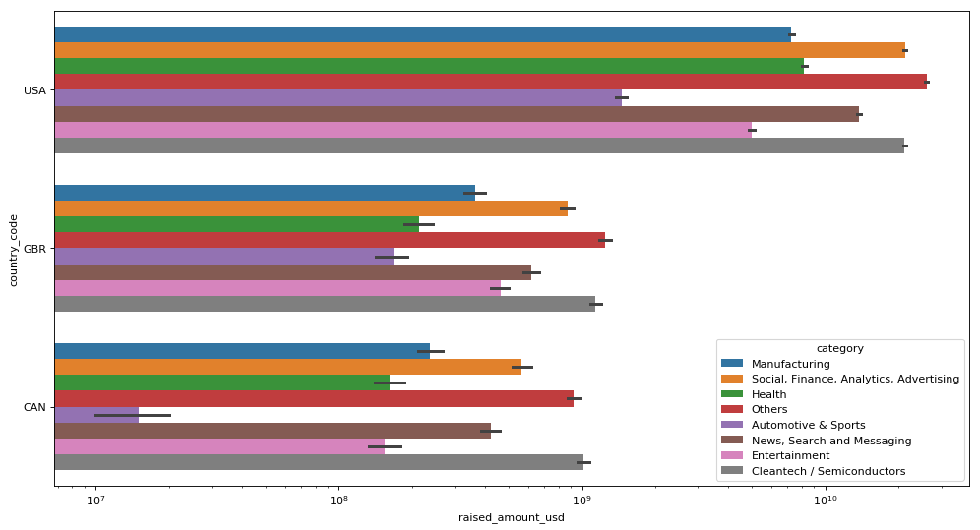
Sector analysis – Country wise

Slide 10
<Conclusions>

